Slide 1
Dictionary of Protein Secondary Structure: Pattern Recognition of Hydrogen-Bonded and Geometrical Features
Wolfgang Kabsch, Christian Sander
BIOINFORMATICS, Vol. 22, no.12 ,Pages 2577–2637, 1983
Presenter: Jun-Shong Lin
Date: October 5, 2006

Slide 2
Abstract
For a successful analysis of the relation between amino acid sequence and protein structure, an unambiguous and physically meaningful definition of secondary structure is essential. We have developed a set of simple and physically motivated criteria for secondary structure, programmed as a pattern-recognition process of hydrogen-bonded and geometrical features extracted from x-ray coordinates. Cooperative secondary structure is recognized as repeats of the elementary hydrogen-bonding patterns “ turn” and “bridge”. Repeating turns are “helices”, repeating bridges are “ladders”, connected ladders are “sheets”. Geometric structure is defined in terms of the concepts torsion and curvature of differential geometry.

Slide 3
Abstract(cont.)
Local chain chirality is the torsional handedness of four consecutive C^{α} positions and is positive for right-handed helices and negative for ideal twisted β-sheets. Curved pieces are defined as “bends”. Solvent “exposure” is given as the number of water molecules in possible contact with a residue. The end result is a compilation of the primary structure, including SS bonds, secondary structure, and solvent exposure of 62 different globular proteins. The presentation is in linear form: strip graphs for an overall view and strip tables for the details of each of 10,925 residues. The dictionary is also available in computer-readable form for protein structure prediction work.

Slide 4
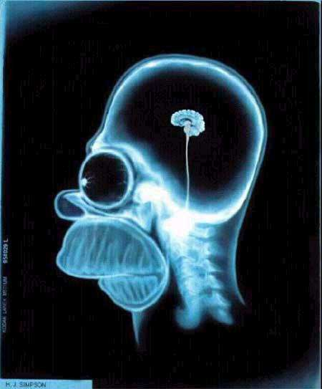
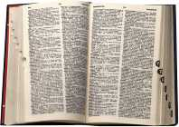
Introduction
Focus on secondary structure prediction.
Dictionary of Proteins
Pattern recognition algorithm
Xray-coordinates
From the Protein Data Bank
Hydrogen-Bonded and
Geometrical Features

Slide 5
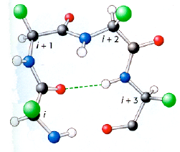
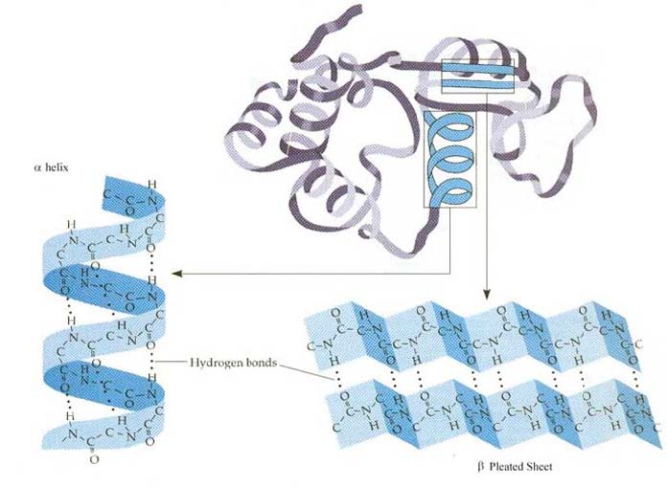
Definitions
The definitions of H-bonded features from a hierarchy:
α-helices
and
β-ladders
Turns
and
Bridges
H-bonds are defined

Slide 6
Hydrogen Bonds
C,O (+q₁ , -q₁ ) and N,H (-q₂ , +q₂ )
q₁=0.42e ,q₂=0.2e
C
R_{i}
C_{a}
H
N
C
H
O
O
=
=
H
O
N
C
N
C_{a}
R_{j}
電負度:F(4)>O(3.5)>N、Cl(3.0)>Br(2.8)>I(2.6)>C、S(2.5)>H(1)

Slide 7

Hydrogen Bonds
R_{i}
f dimensional factor 332
C_{a}
N
C
H
O
=
=
H
O
N
C
Hbond(i,j) := E < -0.5kcal/mol
C_{a}
R_{j}

Slide 8
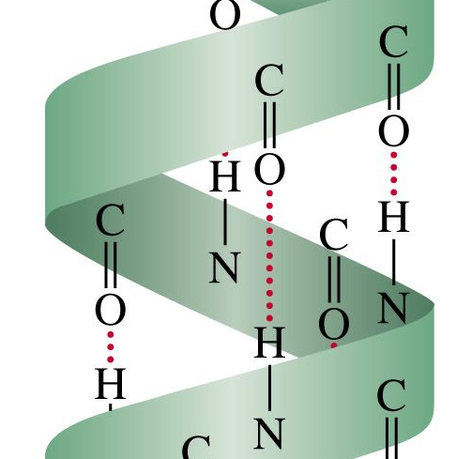
HBondPattern: n-turn
Hbond from CO(i) to NH(i+n):
i
n-turn(i) := Hbond(i,i+n) n=3,4,5
n=0 and n=1 are sterically disallowed, n=2 demands specific conformation!
i+n

Slide 9
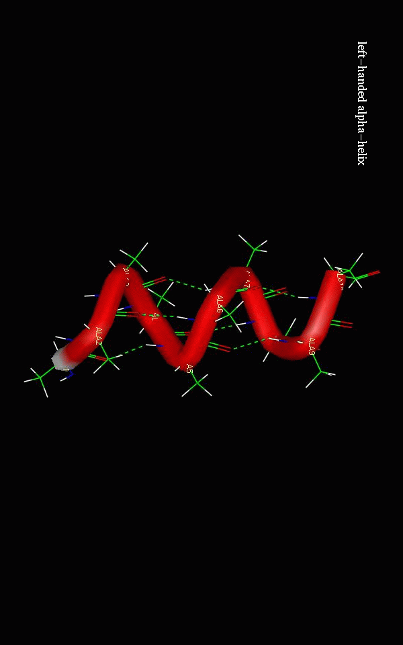
Cooperative Hbond patterns: (1) Minimal Helices
A minimal helix is defined by two consecutive 4-turns.
4-helix(i,i+3) := [4-turn(i-1) and 4-turn(i)]
Minimal length: 4 residues!
i
i+4
i-1
i+3

Slide 10
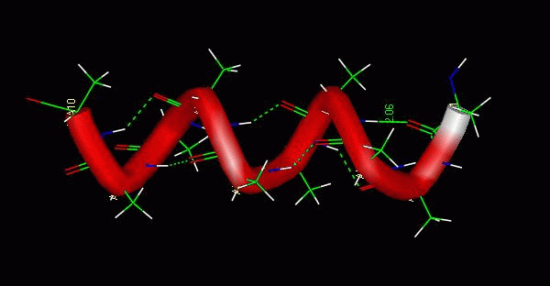
Cooperative Hbond patterns: (1) Minimal Helices
A minimal helix is defined by two consecutive 3-turns.
3-helix(i,i+2) := [3-turn(i-1) and 3-turn(i)]
Minimal length: 3 residues!
i+2
i-1
i+3
i

Slide 11
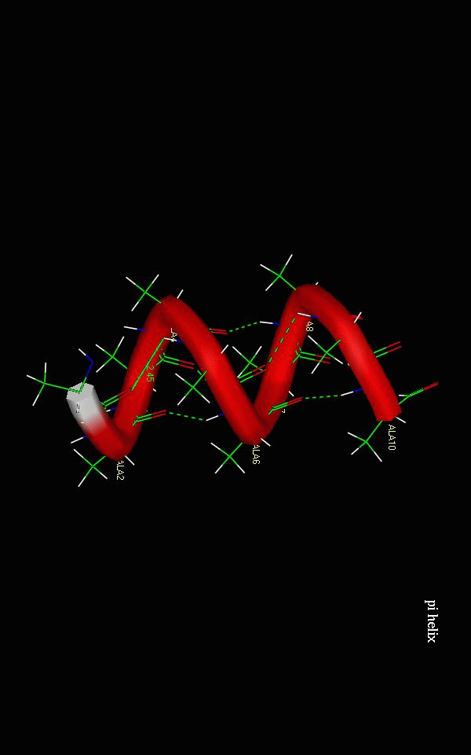
Cooperative Hbond patterns: (1) Minimal Helices
A minimal helix is defined by two consecutive 5-turns.
5-helix(i,i+4) := [5-turn(i-1) and 5-turn(i)]
Minimal length: 5 residues!
i+4
i+5
i-1
i

Slide 12
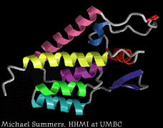
Cooperative Hbond patterns: (2) Helices
α−helix, 3,₁₀-helix, and π-helix as overlap of minimal helices!

Slide 13
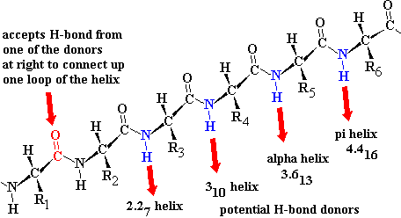
Cooperative Hbond patterns: (2) Helices

Slide 14
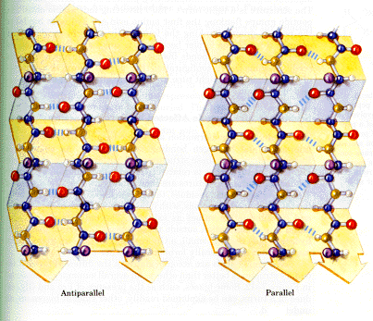
HBondPattern: parallel bridge
Parallel Bridge (i,j) :=
Hbond(i-1,j) and Hbond(j,i+1)
i-1
j
i
R
C_{a}
i+1
N
C
=
H
O

Slide 15
HBondPattern: parallel bridge
Parallel Bridge (i,j) :=
Hbond(i-1,j) and Hbond(j,i+1)
i-1
j
i
R
C_{a}
i+1
N
C
=
H
O

Slide 16
HBondPattern: parallel bridge
Parallel Bridge (i,j) :=
Hbond(i-1,j) and Hbond(j,i+1)
i-1
j
i
R
C_{a}
i+1
N
C
=
H
O

Slide 17
HBondPattern: antiparallel bridge
Antiparallel Bridge (i,j) :=
[Hbond(i,j) and Hbond(j,i)]
or
[Hbond(i-1,j+1) and Hbond(j-1,i+1)]
i-1
i
j
i+1
R
C_{a}
N
C
=
H
O

Slide 18
HBondPattern: antiparallel bridge
Antiparallel Bridge (i,j) :=
[Hbond(i,j) and Hbond(j,i)]
or
[Hbond(i-1,j+1) and Hbond(j-1,i+1)]
i-1
i
j
i+1
R
C_{a}
N
C
=
H
O

Slide 19
HBondPattern: antiparallel bridge
Antiparallel Bridge (i,j) :=
[Hbond(i,j) and Hbond(j,i)]
or
[Hbond(i-1,j+1) and Hbond(j-1,i+1)]
i-1
i
j
i+1
R
C_{a}
N
C
=
H
O

Slide 20
HBondPattern: antiparallel bridge
Antiparallel Bridge (i,j) :=
[Hbond(i,j) and Hbond(j,i)]
or
[Hbond(i-1,j+1) and Hbond(j-1,i+1)]
j+1
i-1
j
i
j-1
i+1
R
C_{a}
N
C
=
H
O

Slide 21
HBondPattern: antiparallel bridge
Antiparallel Bridge (i,j) :=
[Hbond(i,j) and Hbond(j,i)]
or
[Hbond(i-1,j+1) and Hbond(j-1,i+1)]
j+1
i-1
j
i
j-1
i+1
R
C_{a}
N
C
=
H
O

Slide 22
HBondPattern: antiparallel bridge
Antiparallel Bridge (i,j) :=
[Hbond(i,j) and Hbond(j,i)]
or
[Hbond(i-1,j+1) and Hbond(j-1,i+1)]
j+1
i-1
j
i
j-1
i+1
R
C_{a}
N
C
=
H
O

Slide 23
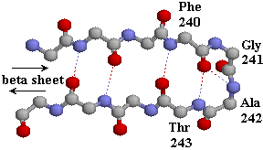
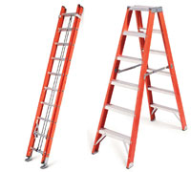
Cooperative Hbond patterns: (3) Ladders
Ladder: set of one or more consecutive bridges of identical type

Slide 24
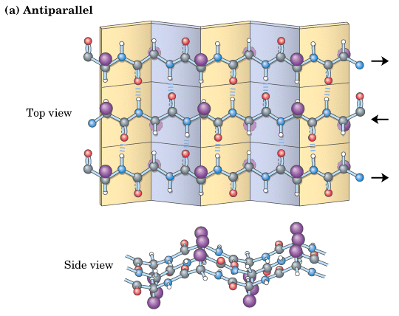
Cooperative Hbond patterns: (3) Ladders
Sheet: set of one or more ladders connected by shared residues
3 strands, 2 ladders.

Slide 25
Geometrical Features: Bend
Bend(i):=[angle{( Ca (i)- Ca(i-2)), (Ca(i+2),- Ca(i))} > 70°]
i
i+1
i-1
i-2
i+2
> 70º

Slide 26
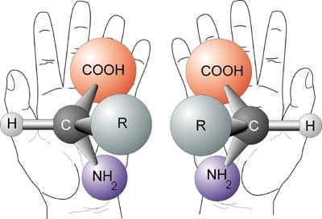
Geometrical Features: Chirality
α (i) = dihedral angle( C^{α} _{i-1}, C^{α} _{i}, C^{α} _{i+1}, C^{α} _{i+2} )
+: if 0° < α < 180°
-: if –180° < α < 0°
C^{α}_{i-1}
C^{α}_{i+2}
i-1
i
i+1
-
α
i+2
+
Most helices have positive, most twisted
β-ladders negative.
C^{α}_{i}
C^{α}_{i+1}

Slide 27
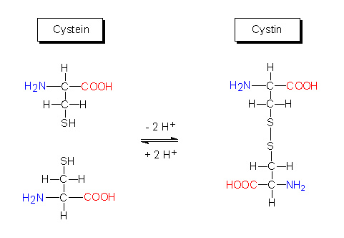
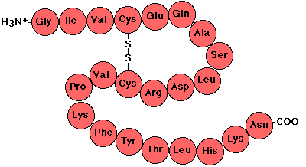
Geometrical Features: SSBonds
SS Bonds: covalent bond between S atoms of two residues
S-S distance of less than
3.0 Ǻ can serve as a definition.

Slide 28
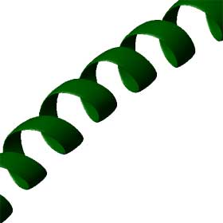
Structure Summary
Structural overlaps are eliminated in this line by giving priority to H,B,E,G,I,T,S in this order.
bend
bend
bend
bend
bend
bend
bend
bend
bend

